Slide 1
U.S. ARMY COMBAT CAPABILITIES DEVELOPMENT COMMAND
GROUND VEHICLE SYSTEMS CENTER
Experiences and Advice from a Robotic System Integration Engineer
11 Aug 2026
DEVCOM GVSC Ground Vehicle Robotics
DISTRIBUTION STATEMENT A. Approved for public release; distribution is unlimited. OPSEC11000
Eduardo Cerame (eduardo.j.cerame.civ@army.mil)

Slide 2

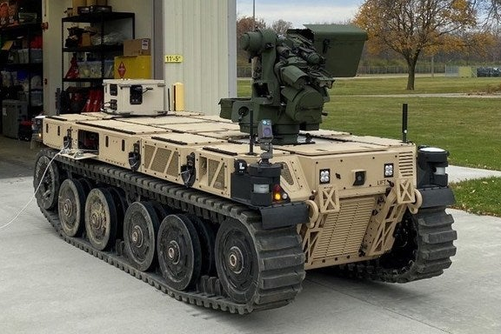
Experiences from a Robotic System Integration Engineer
WHO AM I?
12 years Government Employee of GVSC Ground Vehicle Robotics
B.S.E. Mechanical Engineering from University of Michigan Ann Arbor
Supported Projects with Both Optionally Manned and Fully Robotic Systems
  System Integration Lab (SIL) Lead for Multiple Efforts
  E-Stop and Testing Operator of Autonomous Robotic Platforms
  Supported Training of Soldiers at Operational Experiments
  On-Site and In-Lab Integration of Autonomy Systems

Slide 3
1. DON’T UNDERESTIMATE THE COMPLEXITY
Systems Of Systems Often Sound Less Complex Than They Really Are
Plug And Play Systems Or Standards Often Aren’t As Easy As Expected
Be Clear With Documentation And Generate Notes Or Reference Materials For Everyone To Use
Budget Enough Time For Integration And Troubleshooting!
Physics Doesn’t Care How Important Your Program Is!
Notes:
SoS Complexity Example: Put a Remote Camera PTZ on a Remote Vehicle To Be Controlled by an Existing Controller Software that Works When Directly Connected to the Controller
Just need to send command signals and receive video back right? Does the camera talk via ethernet or another protocol requiring a translator (software or hardware)? Are there bandwidth limitations for the radio that’s a concern? Is the video compression format still compatible with the control software if adjustments are made to account for radio limitations? Are there any safety concerns needed for control of the camera requiring validation checks in the software? Are there firewall or network routing adjustments/additions that need to be made?
Plug and Play: Standards work if everyone follows them and it’s an ideal architecture. Prototype software may not actually be compliant or may require breaking small parts of the standard for functionality. Is the software flexible enough to scale up if multiple of the plug and play components are on the network or could they conflict? Is the network designed so that the messages will remain working with the standard?
It’s easy for a simple miscommunication between groups to snowball or get missed until late in an effort when it causes problems. Make sure the communication is open, decisions are documented, and roles or key actions are assigned in a way that everyone can see. Ex. Two components are going to be connected, both sides agree to use an IOP A connector and determine who’s going to have the pin side and socket side, etc. But they don’t determine series 2 or series 3 38999 connector, so they aren’t interchangeable
No matter how much you think is ready to go for easy integration, assume certain things won’t go smoothly and you’ll need time to solve issues.
Requirements need to be realistic.

Slide 4
2. Utilize Benchtop and Lab Setups Intelligently
Field Testing Is Slow and Expensive!
Simulations can be your best friend
  Understand the limits!
Plan Properly for Your Benchtop or SIL Setups
Notes:
Only testing in the field on a full system is expensive (often slow, needs more people, more logistics, and can easily turn into hurry up and wait for a lot of people). Memories of way too much time spent by engineers helping setup tents to operate out of. Lots of time can get wasted if one subsystem goes down that derails testing.
Testing in a SIL with simulations can allow you to catch the simple and silly mistakes early when it’s cheap and fast. You can also look for corner cases that are hard to test in the real world. Not every thing can be tested at once in simulation/SIL environments. B-Kit vs A-Kit examples and benchtop vs simulation sensors
Budget time and components to get SIL hardware at the start of integration. Don’t steal parts for spares!

Slide 5
3. Avoid Configuration hell
Prepare A Plan For Managing Software And Hardware Configurations At The START Of Your Program
Don’t Let Configuration Management Slide, It Will Be Difficult To Get Back On Track
Document Processes and Key Lessons Learned As You Go, Don’t Assume You Will Remember

